Slide 1
Transport Layer in Computer
Networks
Lecture (Theory)
Department of Computer Science and Engineering,
Chitkara University, Punjab

Slide 2
OUTLINES
Introduction
Services
Connection Less and Connection Oriented protocol
Transport Layer Protocols
TCP Connection
UDP

Slide 3
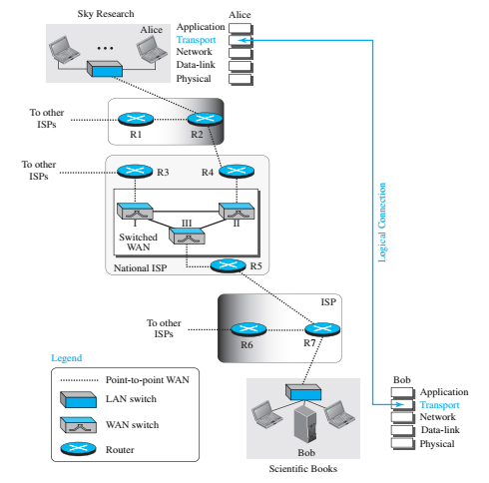
INTRODUCTION
Locates between the application layer and the network layer.
Provides a process-to-process communication between two application layers, one at the local host and the other at the remote host.
Figure1: ﻿Logical connection at the transport layer

Slide 4
INTRODUCTION
﻿﻿Figure 1 shows a scenario in which a scientist working in a research company, Sky Research, needs to order a book related to her research from an online bookseller, Scientific Books.
﻿Five different levels of communication between Alice, the computer on which the scientist is working, and Bob, the computer that provides online service.
Communication at application, transport, network, or data-link is logical; communication at the physical layer is physical.
For simplicity, only ﻿host-to-router, router-to-router, and router-to-host are shown, but the switches are also involved in the physical communication.
Although Alice and Bob need to exchange data, communication at the physical layer means exchanging signals. Data need to be transmitted and received, but the media have to change data to signals.
Both data and the signals that represent them can be either analog or digital in form.

Slide 5
TRANSPORT LAYER SERVICES
Process to Process Communication
Addressing
Encapsulation and Decapsulation
Flow Control
Error Control
Congestion Control

Slide 6
TRANSPORT LAYER SERVICES
Process to Process Communication
﻿A transport-layer protocol is responsible for delivery of the message to the appropriate process of destination computer.
Addressing
﻿ The most common way to achieve process-to-process communication is through the client-server paradigm.
A process on the local host (client), needs services from a process usually on the remote host (server).
For communication, the local host and the remote host are defined using IP addresses. To define the processes, second identifiers, called port numbers are also required.

Slide 7
TRANSPORT LAYER SERVICES
Encapsulation and Decapsulation
﻿Encapsulation happens at the sender site. When a process has a message to send, it passes the message to the transport layer. The transport layer receives the data and adds the transport-layer header. The packets at the transport layer in the Internet are called user datagrams, segments, or packets, depending on what transport-layer protocol.
﻿Decapsulation happens at the receiver site. When the message arrives at the destination transport layer, the header is dropped and the transport layer delivers the message to the process running at the application layer.

Slide 8
TRANSPORT LAYER SERVICES
Flow Control
﻿Whenever an entity produces items and another entity consumes them, there should be a balance between production and consumption rates. If the items are produced faster than they can be consumed, the consumer can be overwhelmed and may need to discard some items. If the items are produced more slowly than they can be consumed, the consumer must wait, and the system becomes less efficient. Flow control is related to the first issue.
﻿Error control at the transport layer is responsible for
Detecting and discarding corrupted packets.
Keeping track of lost and discarded packets and resending them.
Recognizing duplicate packets and discarding them.
Buffering out-of-order packets until the missing packets arrive.

Slide 9
TRANSPORT LAYER SERVICES
Congestion Control
﻿ Congestion in a network may occur if the load on the network, the number of packets sent to the network, is greater than the capacity of the network, the number of packets a network can handle.
Congestion control refers to the mechanisms and techniques that control the congestion and keep the load below the capacity

Slide 10
CONNECTION-LESS AND CONNECTION-ORIENTED PROTOCOL
At the transport layer, a logical connection between two transport layers is concerned rather than physical paths of packets
Two Types of Services
Connection-less Service
Connection-oriented Service

Slide 11
CONNECTION-LESS AND CONNECTION-ORIENTED PROTOCOL
Connection-less Service
The source process (application program) needs to divide its message into chunks of data of the size acceptable by the transport layer and deliver them to the transport layer one by one
﻿Treats each chunk as a single unit without any relation between the chunks.
When a chunk arrives from the application layer, the transport layer encapsulates it in a packet and sends it.
To show the independency of packets, assume that a client process has three chunks of messages to send to a server process.
The chunks are handed over to the connectionless transport protocol in order.
However, since there is no dependency between the packets at the transport layer, the packets may arrive out of order at the destination and will be delivered out of order to the server process

Slide 12
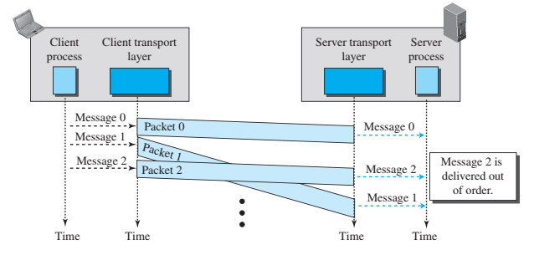
CONNECTION-LESS AND CONNECTION-ORIENTED PROTOCOL
Figure: Connection-less Service

Slide 13
CONNECTION-LESS AND CONNECTION-ORIENTED PROTOCOL
Connection-oriented Service
﻿The client and the server first need to establish a logical connection between themselves
﻿The data exchange can only happen after the connection establishment. After data exchange, the connection needs to be torn down
﻿Transport layer connection-oriented service involves only the two hosts; the service is end to end.
﻿Flow control, error control, and congestion control can be implemented in a connection oriented protocol.

Slide 14
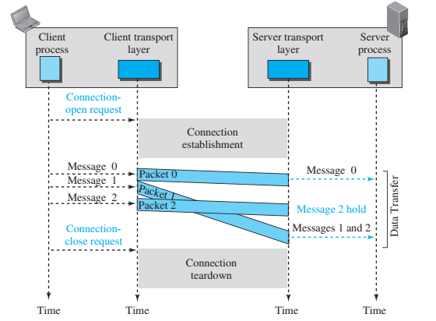
CONNECTION-LESS AND CONNECTION-ORIENTED PROTOCOL
Figure: Connection-oriented Service

Slide 15
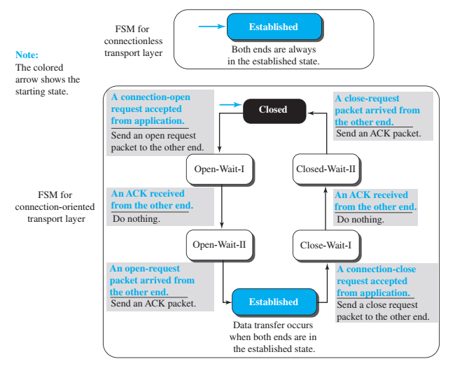
CONNECTION-LESS AND CONNECTION-ORIENTED PROTOCOL
Figure: Connection-less and Connection-oriented Service represented as FSM

Slide 16
TRANSMISSION CONTROL PROTOCOL (TCP)
﻿A TCP connection provides a full-duplex service: If there is a TCP connection between Process A on one host and Process B on another host, then application layer data can flow from Process A to Process B at the same time as application layer data flows from Process B to Process A.
A TCP connection is also always point-to-point, that is, between a single sender and a single receiver.
﻿The client first sends a special TCP segment; the server responds with a second special TCP segment; and finally the client responds again with a third special segment.
The first two segments carry no payload, that is, no application-layer data; the third of these segments may carry a payload. Because three segments are sent between the two hosts, this connection-establishment procedure is often referred to as a three-way handshake.

Slide 17
TRANSPORT LAYER PROTOCOLS
Simple Protocol
Stop and Wait Protocol
Go-Back-N Protocol
Selective-Repeat Protocol
﻿Bidirectional Protocols: Piggybacking

Slide 18
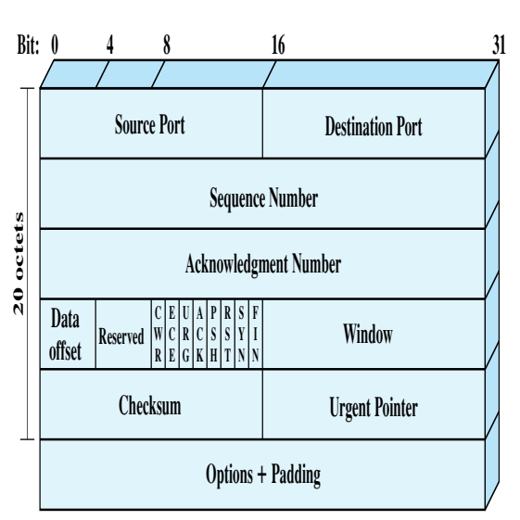
TRANSMISSION CONTROL PROTOCOL (TCP)
TCP Header

Slide 19
TRANSMISSION CONTROL PROTOCOL (TCP)
﻿﻿Source Port (16 bits): Source TCP user. Example values are Telnet 23; ﻿
TFTP = 69; HTTP = 80
Destination Port (16 bits): Destination TCP user.
Sequence Number (32 bits): Sequence number of the first data octet in this segment except when the SYN flag is set. If SYN is set, this field contains the initial sequence number (ISN) and the first data octet in this segment has sequence number ISN + 1
﻿Acknowledgment Number (32 bits): Contains the sequence number of the next data octet that the TCP entity expects to receive.
Data Offset (4 bits): Number of 32-bit words in the header.
Reserved (4 bits): Reserved for future use.

Slide 20
TRANSMISSION CONTROL PROTOCOL (TCP)
Flags (6 bits): For each flag, if set to 1, the meaning is
CWR: congestion window reduced.
ECE: ECN-Echo; the CWR and ECE bits, are used for the explicit congestion notification function
URG: urgent pointer field significant.
ACK: acknowledgment field significant.
PSH: push function.
RST: reset the connection.
SYN: synchronize the sequence numbers.
FIN: no more data from sender

Slide 21
TRANSMISSION CONTROL PROTOCOL (TCP)
﻿Window (16 bits): Flow control credit allocation, in octets. Contains the number of data octets, beginning with the sequence number indicated in the acknowledgment field that the sender is willing to accept.
Checksum (16 bits): The ones complement of the ones complement sum of all the 16-bit words in the segment plus a pseudo header, described subsequently.
Urgent Pointer (16 bits): This value, when added to the segment sequence number, contains the sequence number of the last octet in a sequence of urgent data. This allows the receiver to know how much urgent data is coming.
Options (Variable): An example is the option that specifies the maximum segment size that will be accepted.

Slide 22
USER DATAGRAM PROTOCOL (UDP)
﻿UDP provides a connectionless service for application-level procedures.
Thus, UDP is basically an unreliable service; delivery and duplicate protection are not guaranteed.
However, this does reduce the overhead of the protocol and may be adequate in many cases.

Slide 23
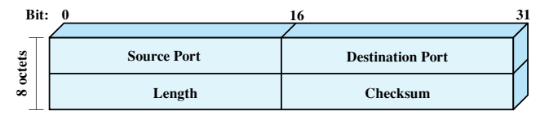
USER DATAGRAM PROTOCOL (UDP)
UDP Header
﻿The header includes a source port and destination port.
The Length field contains the length of the entire UDP segment, including header and data.
The checksum is the same algorithm used for TCP and IP.
For UDP, the checksum applies to the entire UDP segment plus a pseudoheader prefixed to the UDP header at the time of calculation and which is the same pseudoheader used for TCP.
If an error is detected, the segment is discarded and no further action is taken.
The Checksum field in UDP is optional. If it is not used, it is set to zero.

Slide 24
REFERENCES:
Data Communications and Networking by Forouzan, 5th edition, 2013.
Computer Networks By Andrew S. Tanenbaum 5th edition, Pearson Education,2013.
Data and computer Communications by William Stallings, 8th edition, Pearson,2007.
CCNA Cisco Certified Network Associate Study Guide, by Todd Lammle, Wiley, 7th edition,2011.
Computer Networking: A Top-Down Approach, by Kurose and Ross, Pearson Education, 6th edition,2013.

Slide 25
Thank you

